Slide 1
Getting Ready to Work in a Tech Start-up

Slide 2
Introduction
Your placement (or internship) is an opportunity to build on your technical skills and experience different work environments. Your tech skills are important and valued, but your approach to work and new colleagues is also very important.
To support your journey, we have a series of short presentations to help you prepare for working in a tech start-up.
Each link connects to a theme to support your thinking and work habits. Please click through these slides and play each video.

Slide 3
Mindset

Slide 4
Mindset
In the context of your placement, mindset is your ability to respond to opportunities and challenges in a positive and proactive way.
What is called an entrepreneurial mindset is how receptive you are to solving problems and creating change for the organisation and its customers. This skill is highly sought-after by future employers and can improve your academic results.
The following video explores the ideas of mindset.

Slide 5
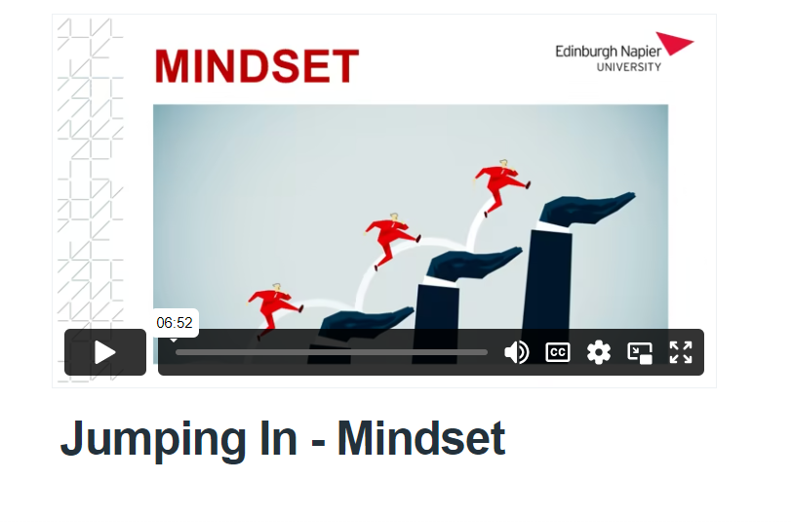
Mindset

Slide 6
Mindset: Actions
Think about how you perceive your current mindset and how this compares to a more entrepreneurial mindset.
What areas around mindset and attitude might you wish to work on?
How might you do this?

Slide 7
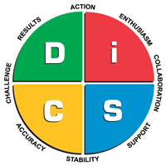
Learning to work with others
There are a number of learning models that help us better understand and know who we are and also understand others. This is essential for our working lives.
DISC stands for four personality profiles: (D)ominance, (I)nfluence, (S)teadiness and (C)onscientiousness.
By understanding how we prefer to think, prefer to make decisions and communicate, we can gain insights into our preferred style of working but also how others prefer to operate.

Slide 8
Know yourself and understand others
This short video explores how you can develop your preferred working style to work effectively with others.

Slide 9
Learning to work with others: Actions
How would you describe your preferred style of working?
Why might this be different to other colleagues that you have to work with?
Do you have to change? If you have a preferred style how do you understand other people’s preferred style?
Understanding your preferred working style can be challenging and may take time and practice but is worthwhile and rewarding.

Slide 10
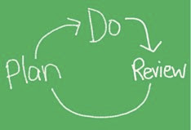
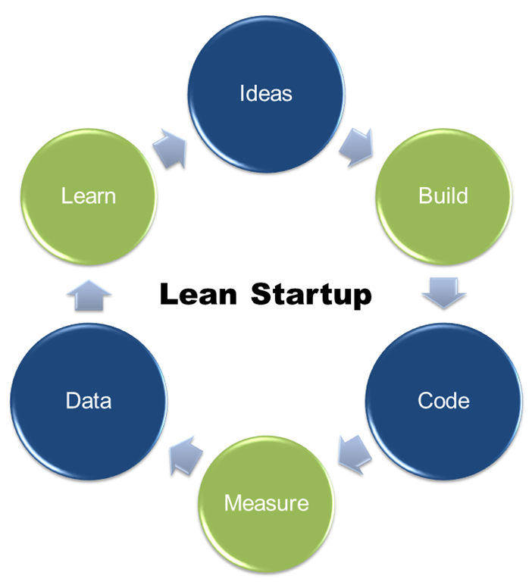
Creating positive habits
Small daily habits can build up over time to deliver lasting impacts.
Cycles of experimentation and reflective actions such as Plan -> Do -> Review help you adjust your habits slowly so they build up to greater impact. Small marginal gains enable you to become more effective and develop more effective practice.
Such good practice matches common product development approaches used such as in lean start-up – think of yourself and good habits as the product!

Slide 11
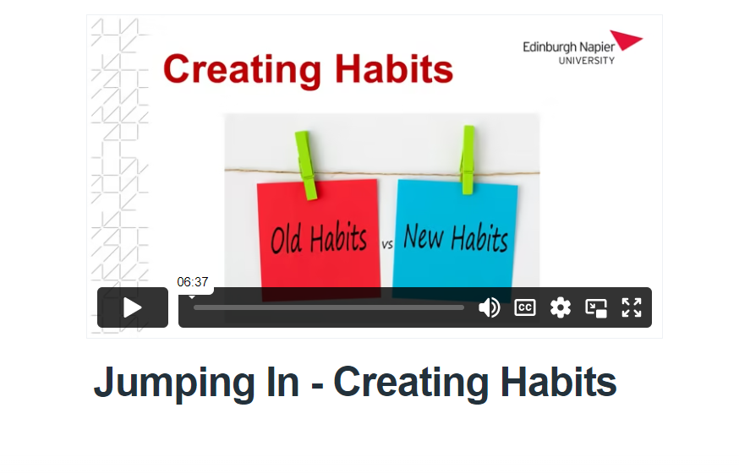
Creating habits – that work for you

Slide 12
Creating positive habits: Actions
Identify one of your habits that you might wish to change over a month
Apply one of models and think about:
Planning what change you wish to make
Making the changes you need to make
What data do you need to collect to show improvements in your habits?
Use the above across a week and then month and see how your habits change!

Slide 13
What’s your “Why?”
What is the purpose of your work in a start-up?
It may be experiential, it may be upskilling, it may be about changing the world or it may be about making some money! There is no one reason that drives our purpose, and your purpose is most likely to change over the course of your working life.
This video focuses on the work of Simon Sinek who explores why your purpose is important as it also helps you to define what you do? and how you do it? This links with an organisation’s culture and values and how you fit with them.

Slide 14
What’s your “Why?”
There is no hierarchy in purpose, for example:
Apple is a global business, driven to produce aesthetically pleasing and good user-design.
Cosmic is a small tech social enterprise, located in Devon, which specialises in digital skills training, digital consultancy, IT technical support and website development. Cosmic’s vision is to inspire people to achieve success in the Digital world. Digital inclusion is at the heart of all they do.
Both are equally valid.

Slide 15
What’s your Why?

Slide 16
What’s your “Why?”: Actions
Think about your values & belief systems and what is important to you. This will help you understand your Why?

Slide 17
Getting ready to work in a tech start-up
By now you should have recognised that there are many opportunities for you to experience in a placement in a tech start-up.
These resources are designed to help guide you through your pathway into your placement and support a positive experience. Your tech start-up placement is one experience in your career but is also an important transition from education into a career in the tech industry both within Scotland and beyond.
We wish you good luck!

Slide 18
Keep in touch
@eplacementscot
/eplacementscot
eplacementscot
e-Placement Scotland

